Slide 1
RICH Control Manual
September 20, 2021

Slide 2
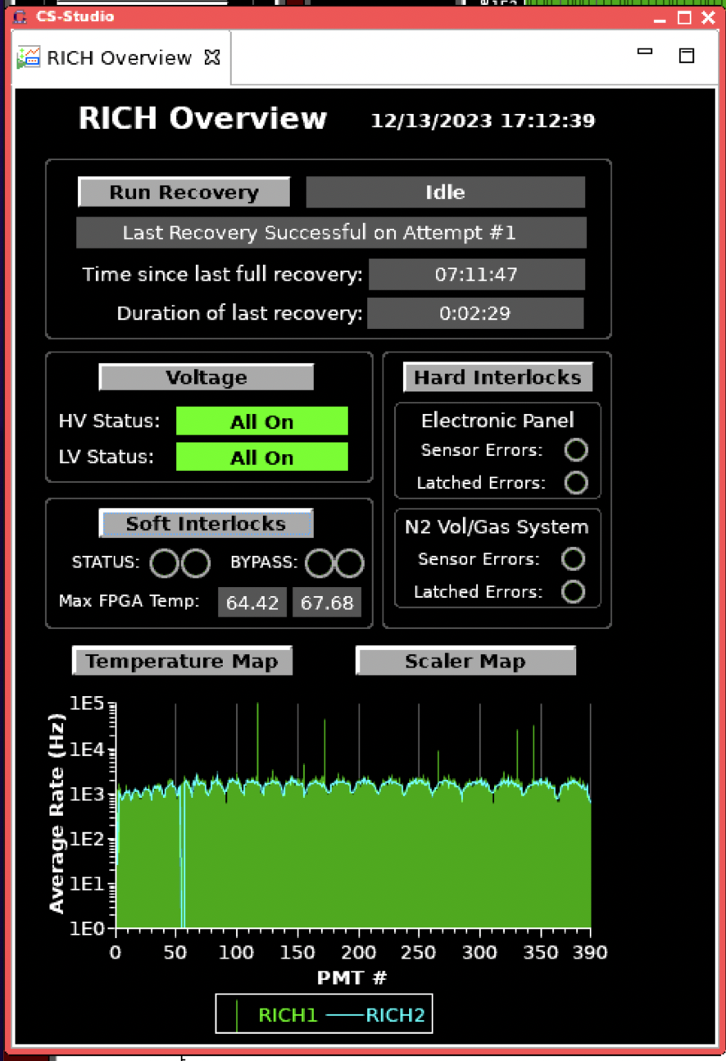
Do full RICH RECOVERY every day shift between runs and in case of missing tiles in the temperature or scaler plots
RICH front-end is sitting in the beam of the secondary particles. The radiation damage causes the malfunction of FE . Dead tiles appear. The damage is not permanent. It can be recovered by switching LV OFF/ON.
One click RICH recovery procedure
RICH LV OFF/ON
Verify the number of live tiles
Repeat 1) if RICH still has dead tiles
Reboot rich4
Start new run with CANCEL-RESET!

Slide 3
RICH mainframe remote reboot
In case of communication lost with the RICH mainframe try to reboot it remotely
To reboot only the CPU: caenhvReset.py --soft hvrich1
To power cycle the whole thing, causing all voltages to go to zero: caenhvReset.py —-hard hvrich1

Slide 4
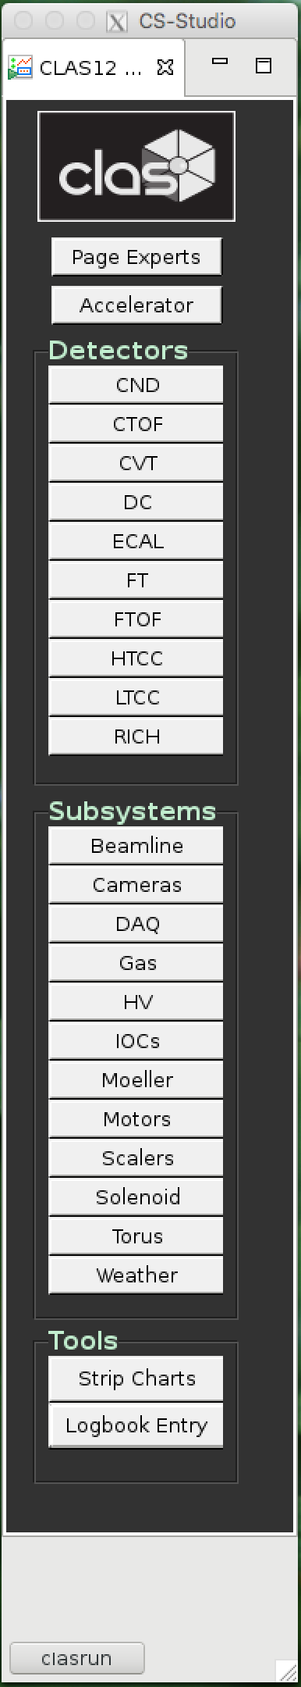
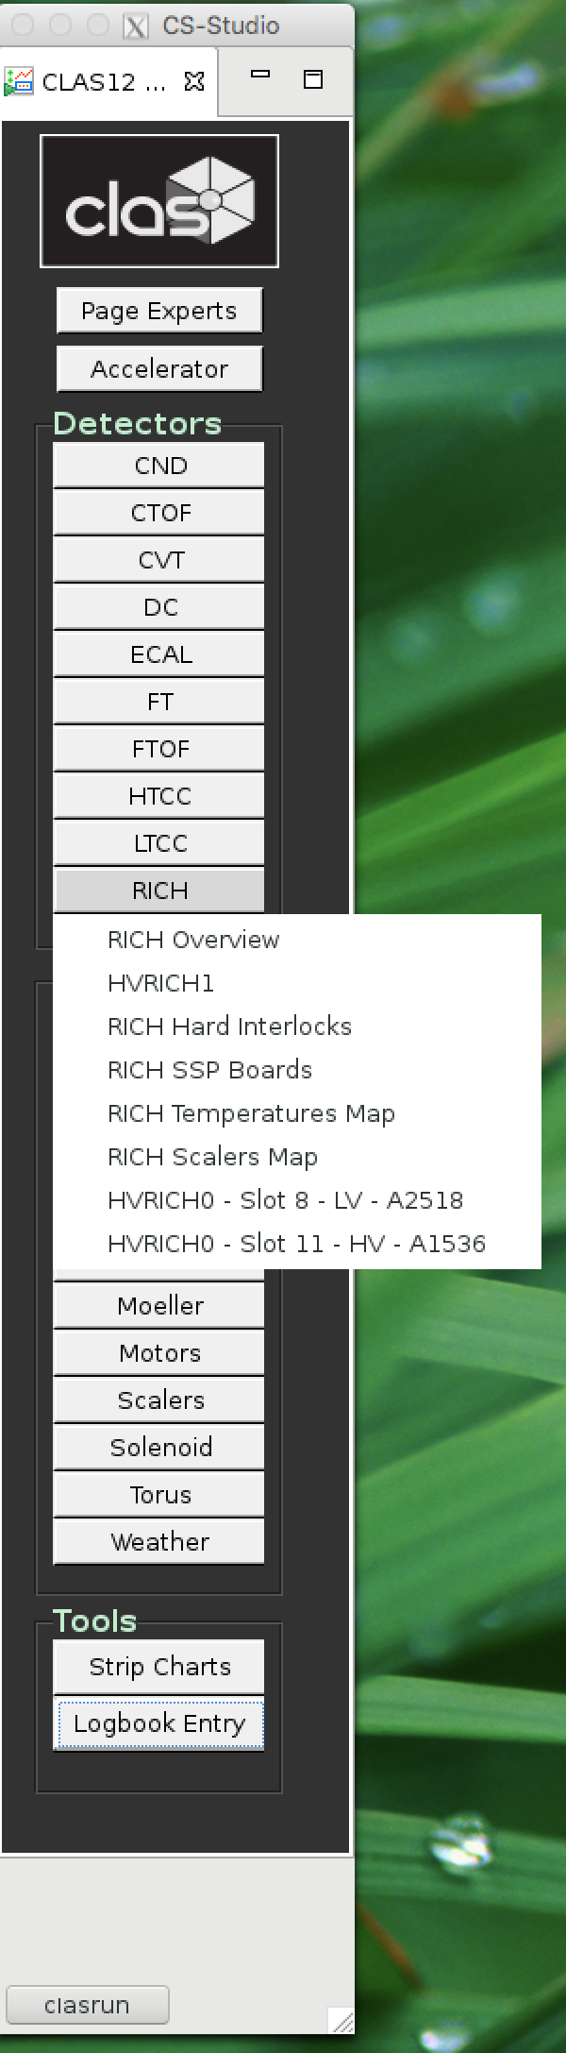
Press RICH on clascss menu
Chose RICH Overview

Slide 5
RICH Overview
Voltage control RICH HV and LV
Temperature Map
Shows the temperature of the RICH electronic boards
Scaler Map
Presents the rate of the MAPMT pixels
Hard Interlock
Control the RICH interlock
Soft Interlock
Control the max temperature of the FPGA chips

Slide 6
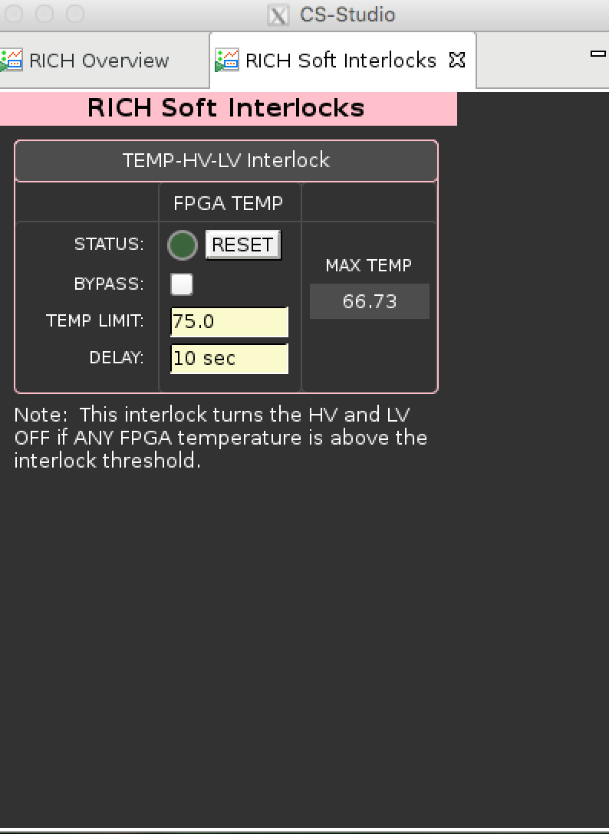
Soft Interlock
Max temperature has to be less than 75 C
Reset the interlock if necessary

Slide 7
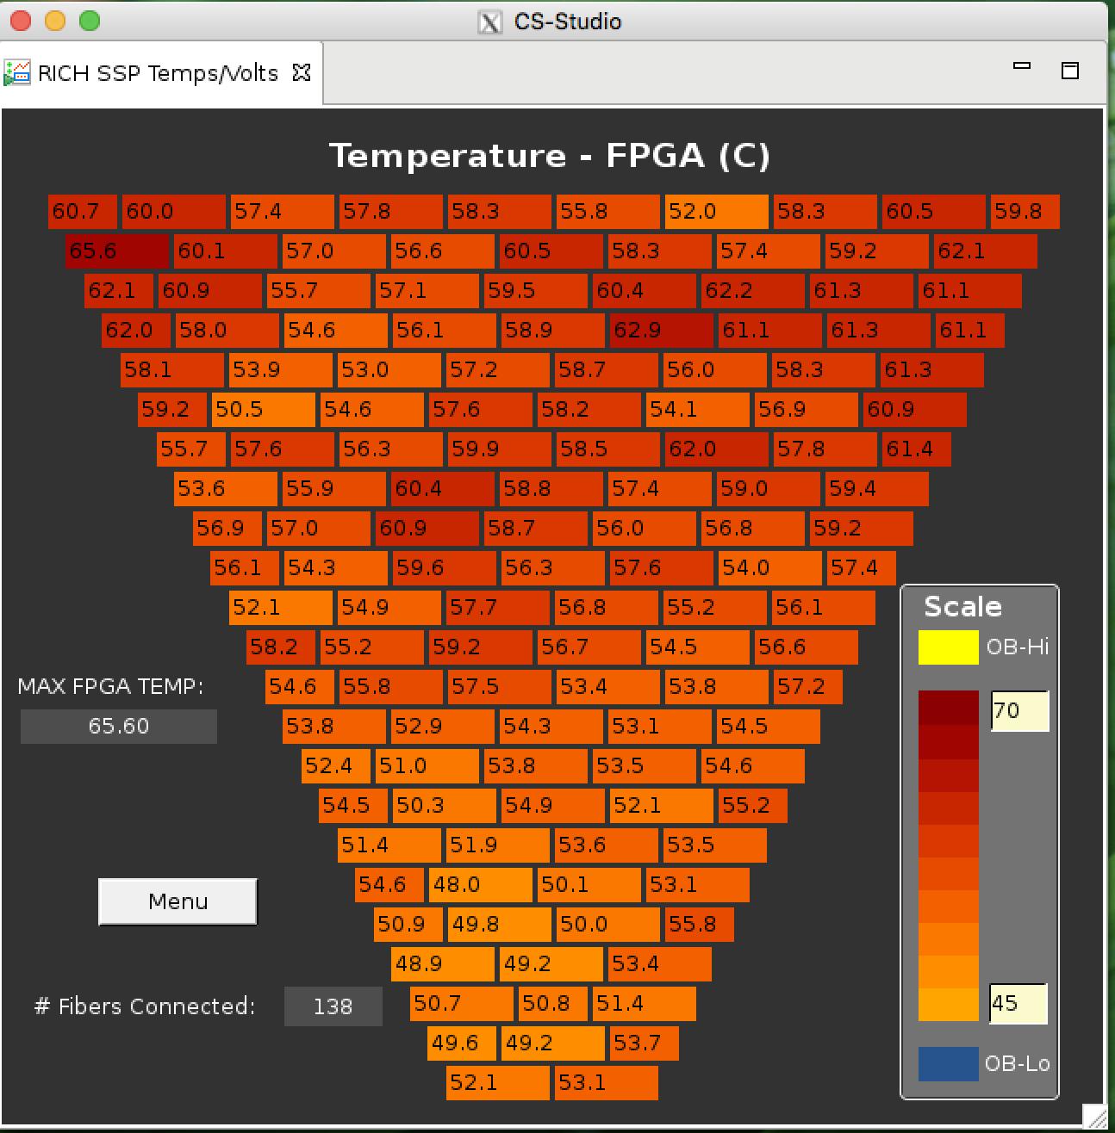
Temperature Map
Max temperature has
to be less than 75 C
Soft interlock switches off
The RICH HV and LV if t>75C⁰
All tiles have to be present
except Tile 21 in sector 1

Slide 8
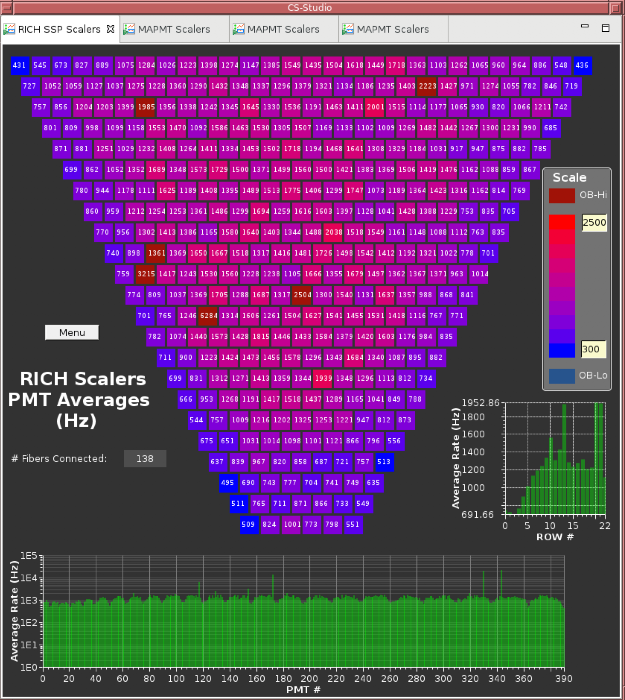
RICH scalers
The plot presents the
average rate of the MAPMT
pixels
ALL MAPMTs have to
be present except Tile 21
in sector 1

Slide 9
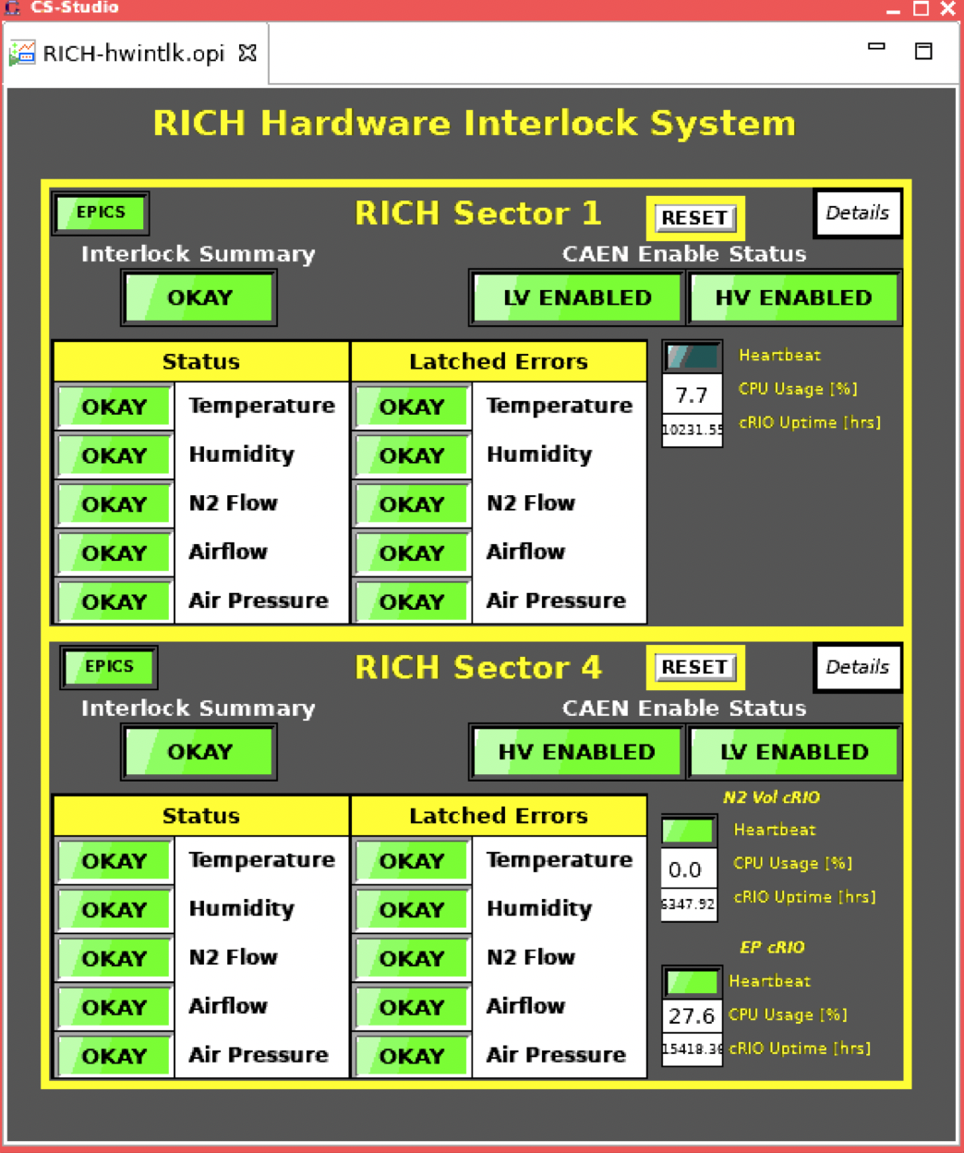
Hard Interlock
controls the
temperature
and humidity
inside the
RICH detector
Press this button
to view the sector 1
panel
Press this button
to view the sector 4
panel

Slide 10
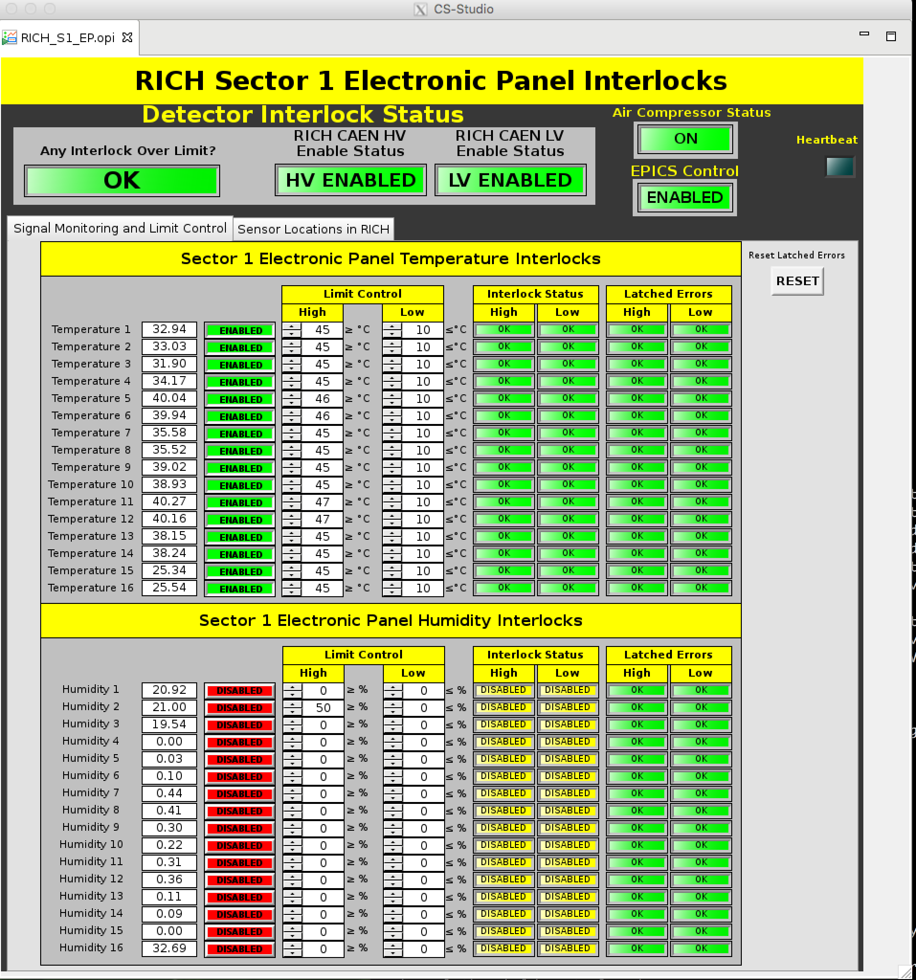
Electronic Volume Interlock
Check the temperature and humidity

Slide 11
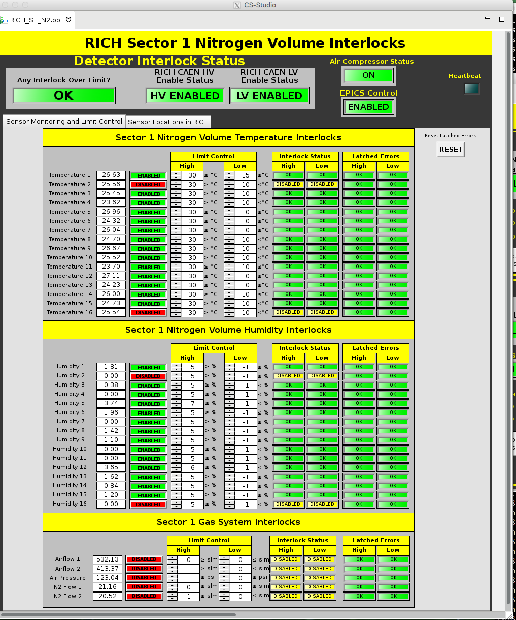
Nitrogen Volume Interlock
Check the temperature and humidity

